Slide 1

Orientation to Computing-I
L T P :2 0 0
www.lpu.in Lovely Professional University
1

Slide 2

Unit-2 (Operating System)
Operating System: Operating Systems and its components, Windows Operating Systems Versions and features, Installation process, Directory Hierarchy of Windows Operating System (single level and multiple level), Bootloader
Linux Operating System: Linux OS and its features, Distribution versions, installation process, Directory Hierarchy of Linux System (single level and multiple level). Partitions: Understanding disk partitions and obtaining partition information using system tools, Comparison of windows and Linux OS, Virtual Machines
www.lpu.in Lovely Professional University
2

Slide 3
What is an Operating System?
What is an Operating system?
A program that acts as an intermediate/ interface between a user of a computer and the computer hardware.
Resource allocator (Managing the resources efficiently)
Control Program
Operating system goals:
Execute user programs and make problem solving easier.
Make the computer system convenient to use
Efficiently use available resources
An operating system is the one program that is running at all the times on the computer- usually called the kernel.
Kernel is a program that (allow) let the hardware to recognize and read the program/process.
www.lpu.in Lovely Professional University

Slide 4
Computer System Structure
Computer system can be divided into four components:
Hardware – provides basic computing resources
CPU, memory, I/O devices
Operating system
Controls and coordinates use of resources among various applications and users
System/Application programs – define the ways in which the system resources are used to solving user problems
Word processors, compilers, web browsers, database systems, video games
Users
People, machines, other computers
www.lpu.in Lovely Professional University

Slide 5
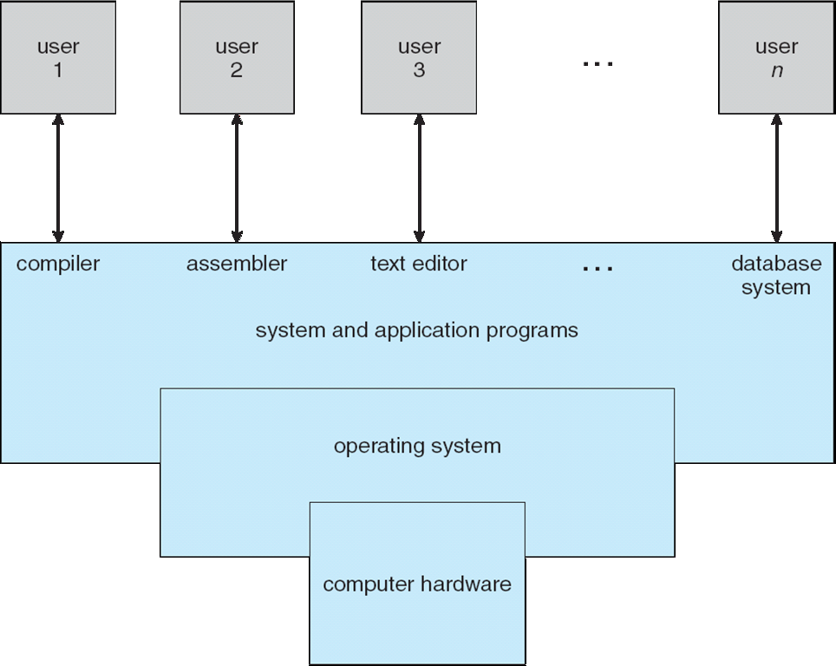
Four Components of a Computer System
www.lpu.in Lovely Professional University

Slide 6
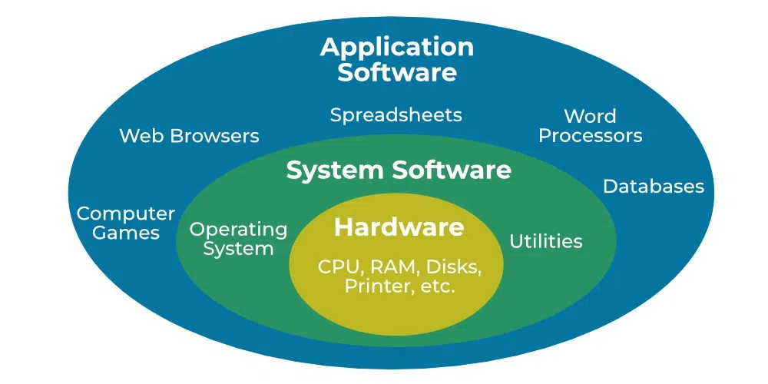
Difference between System Software and Application Software

Slide 7
Application Programs
These programs perform a particular function directly for the users. Some of the common application programs include Email, web browsers, gaming software, word processors, graphics software, media player etc.
System software acts as the interface between the application software and hardware of the computer system. Form example Operating system, device drivers.

Slide 8
System software acts as the interface between the application software and hardware of the computer system.
System software acts as the interface between the application software and hardware of the computer system.

Slide 9
Operating System Services
Operating systems provide an environment for execution of programs and services to programs and users.
The operating-system provides functions that are helpful to the user are:
User interface - Almost all operating systems have a user interface (UI).
Varies between Command-Line (CLI), Graphics User Interface (GUI), touch-screen.
Program execution - The system must be able to load a program into memory and to run that program, end execution, either normally or abnormally (indicating error)
I/O operations - A running program may require I/O, which may involve a file or an I/O device
File-system manipulation - The file system is of particular interest. Programs need to read and write files and directories, create and delete them, search them, list file Information, permission management.

Slide 10
Operating System Services
Communications – Processes may exchange information, on the same computer or between computers over a network
Communications may be via shared memory or through message passing (packets moved by the OS)
Error detection – OS needs to be constantly aware of possible errors
May occur in the CPU and memory hardware, in I/O devices, in user program
For each type of error, OS should take the appropriate action to ensure correct and consistent computing
Debugging facilities can greatly enhance the user’s and programmer’s abilities to efficiently use the system

Slide 11
Operating System Services
Another set of OS functions exists for ensuring the efficient operation of the system itself via resource sharing
Resource allocation - When multiple users or multiple jobs running concurrently, resources must be allocated to each of them
Many types of resources - CPU cycles, main memory, file storage, I/O devices.
Protection and security - The owners of information stored in a multiuser or networked computer system may want to control use of that information, concurrent processes should not interfere with each other
Protection involves ensuring that all access to system resources is controlled
Security of the system from outsiders requires user authentication, extends to defending external I/O devices from invalid access attempts

Slide 12
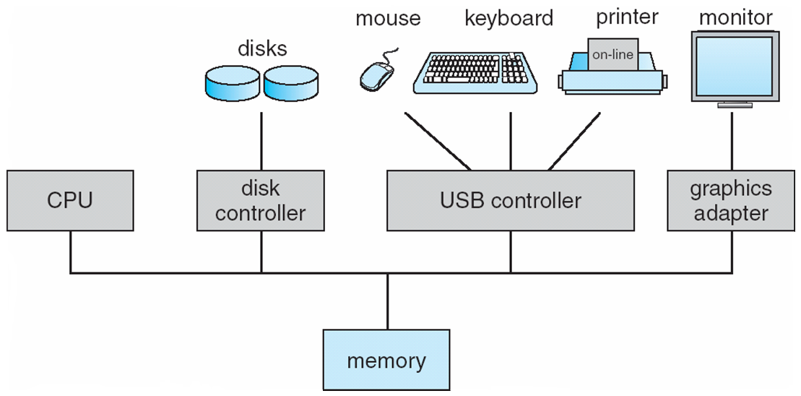
Computer System Organization
Computer-system operation
One or more CPUs, device controllers connect through common bus providing access to shared memory
Concurrent execution of CPUs and devices competing for memory cycles
www.lpu.in Lovely Professional University

Slide 13
Components of Operating System
Process Management
File Management
Network Management
Main Memory Management
Secondary Storage Management
I/O Device Management
Security Management
Command Interpreter System
www.lpu.in Lovely Professional University
13

Slide 14
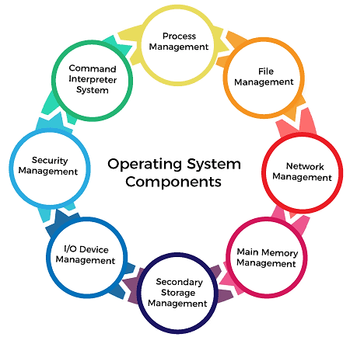
www.lpu.in Lovely Professional University
14

Slide 15
Process management
A program in running state is called a process.
A process needs certain resources including CPU time, Memory, Files, and I/O devices to accomplish its task. The process management component manages the multiple processes running simultaneously on the Operating System.

Slide 16
The operating system is responsible for the following activities in connection with process management:
Create, load, execute, suspend, resume, and terminate processes.
Switch system among multiple processes in main memory.
Provides communication mechanisms so that processes can communicate with each others
Provides synchronization mechanisms to control concurrent access to shared data to keep shared data consistent.
Allocate/de-allocate resources properly to prevent or avoid deadlock situation.

Slide 17
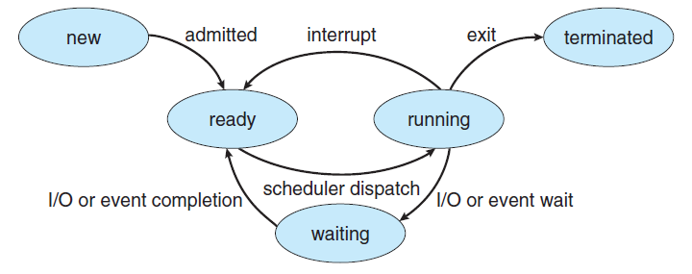
Process life cycle

Slide 18
File management
A files is a sequence of bits, bytes, lines or records whose meaning is defined by its creator and user.
Computers can store information in several different physical forms; magnetic tape, disk, and drum are the most common forms.
A file is defined as a set of correlated information and it is defined by the creator of the file. Mostly files represent data, source and object forms, and programs. Data files can be of any type like alphabetic, numeric, and alphanumeric.

Slide 19
The operating system is responsible for the following activities in connection with file management:
File creation and deletion
Directory creation and deletion
The support of primitives for manipulating files and directories
Mapping files onto secondary storage
File backup on stable (nonvolatile) storage media

Slide 20
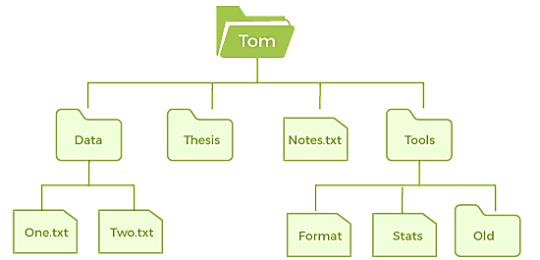
www.lpu.in Lovely Professional University
20

Slide 21
I/O Device Management
One of the purposes of an operating system is to hide the peculiarities of specific hardware devices from the user. I/O Device Management provides an abstract level of H/W devices and keep the details from applications to ensure proper use of devices, to prevent errors, and to provide users with convenient and efficient programming environment.
Following are the tasks of I/O Device Management component:
Hide the details of H/W devices
Manage main memory for the devices using cache, buffer, and spooling
Maintain and provide custom drivers for each device.

Slide 22
Network Management
Network management is the process of administering and managing computer networks. It includes performance management, provisioning of networks, fault analysis, and maintaining the quality of service.
A distributed system is a collection of computers or processors that never share their memory and clock.
In this type of system, all the processors have their local memory, and the processors communicate with each other using different communication cables, such as fibre optics or telephone lines.
The computers in the network are connected through a communication network, which can configure in many different ways.
The network can fully or partially connect in network management, which helps users design routing and connection strategies that overcome connection and security issues.
www.lpu.in Lovely Professional University
22

Slide 23
Functions of Network management
Distributed systems help you to various computing resources in size and function. They may involve minicomputers, microprocessors, and many general-purpose computer systems.
A distributed system also offers the user access to the various resources the network shares.
It helps to access shared resources that help computation to speed up or offers data availability and reliability.
www.lpu.in Lovely Professional University
23

Slide 24
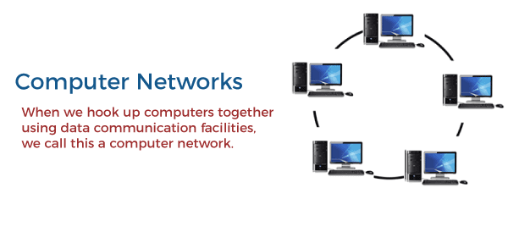
www.lpu.in Lovely Professional University
24

Slide 25
Main Memory Management
Main memory is a large array of storage or bytes, which has an address.
The memory management process is conducted by using a sequence of reads or writes of specific memory addresses.
Main memory is a volatile storage device which means it loses its contents in the case of system failure or as soon as system power goes down.
The main motivation behind Memory Management is to maximize memory utilization on the computer system.

Slide 26
The operating system is responsible for the following activities in connections with memory management:
Keep track of which parts of memory are currently being used and by whom.
Decide which processes to load when memory space becomes available.
Allocate and deallocate memory space as needed.

Slide 27
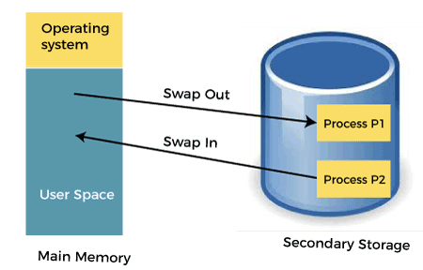
www.lpu.in Lovely Professional University
27

Slide 28
Secondary Storage Management
Since the main memory is too small to permanently accommodate all data and program, the computer system must provide secondary storage to backup main memory.
Most modern computer systems use disks as the principle on-line storage medium, for both programs and data. Most programs, like compilers, assemblers, sort routines, editors, formatters, and so on, are stored on the disk until loaded into memory, and then use the disk as both the source and destination of their processing.

Slide 29
Today modern computers use hard drives/SSD as the primary storage of both programs and data.
However, the secondary storage management also works with storage devices, such as USB flash drives and CD/DVD drives.
The operating system is responsible for the following activities in connection with disk management:
Free space management
Storage allocation
Disk scheduling

Slide 30
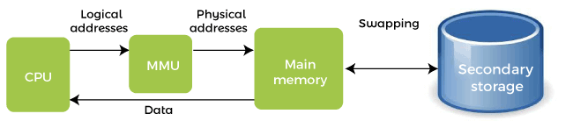
www.lpu.in Lovely Professional University
30

Slide 31
Security Management
Security Management refers to a mechanism for controlling the access of programs, processes, or users to the resources defined by a computer controls to be imposed, together with some means of enforcement.

Slide 32
Security Management
The various processes in an operating system need to be secured from other activities.
Therefore, various mechanisms can ensure those processes that want to operate files, memory CPU, and other hardware resources should have proper authorization from the operating system.
Security refers to a mechanism for controlling the access of programs, processes, or users to the resources defined by computer controls to be imposed, together with some means of enforcement.
For example, memory addressing hardware helps to confirm that a process can be executed within its own address space.
The time ensures that no process has control of the CPU without renouncing it.
www.lpu.in Lovely Professional University
32

Slide 33
Security Management
No process is allowed to do its own I/O to protect, which helps you to keep the integrity of the various peripheral devices.
Security can improve reliability by detecting latent errors at the interfaces between component subsystems.
Early detection of interface errors can prevent the foulness of a healthy subsystem by a malfunctioning subsystem.
An unprotected resource cannot misuse by an unauthorized or incompetent user.
www.lpu.in Lovely Professional University
33

Slide 34
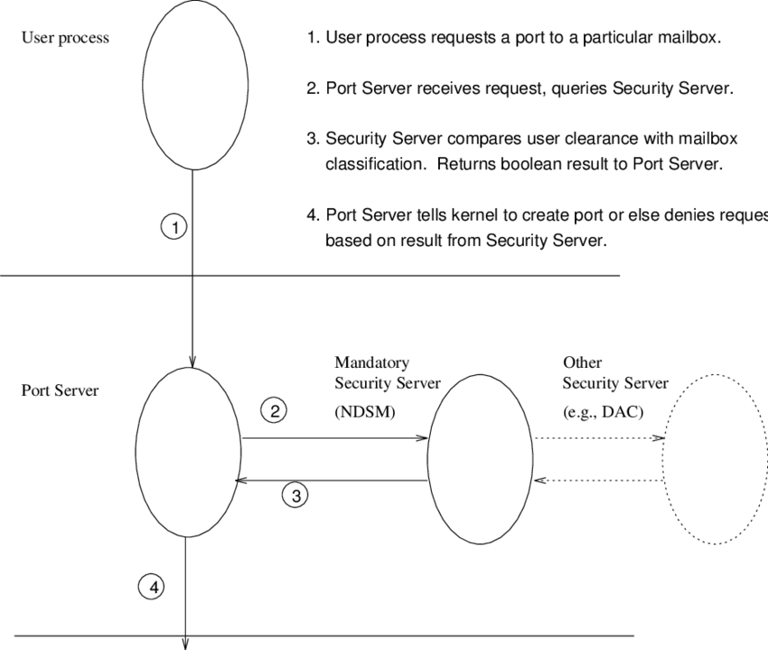

Slide 35
Command Interpreter System
One of the most important components of an operating system is its command interpreter. The command interpreter is the primary interface between the user and the rest of the system.
Many commands are given to the operating system by control statements. A program that reads and interprets control statements is automatically executed when a new job is started in a batch system or a user logs in to a time-shared system. This program is variously called:
The control card interpreter,
The command-line interpreter,
The shell (in UNIX), and so on.
Its function is quite simple, get the next command statement, and execute it. The command statements deal with process management, I/O handling, secondary storage management, main memory management, file system access, protection, and networking.
www.lpu.in Lovely Professional University
35

Slide 36
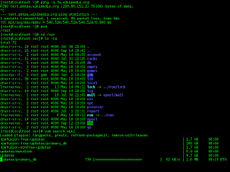
Command line Interpreter
.

Slide 37
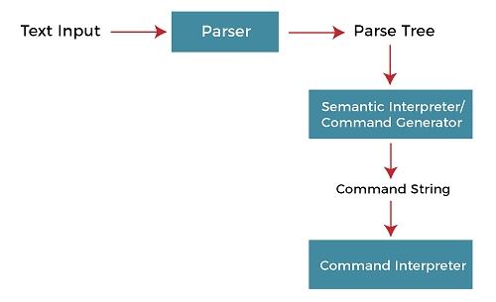
www.lpu.in Lovely Professional University
37

Slide 38
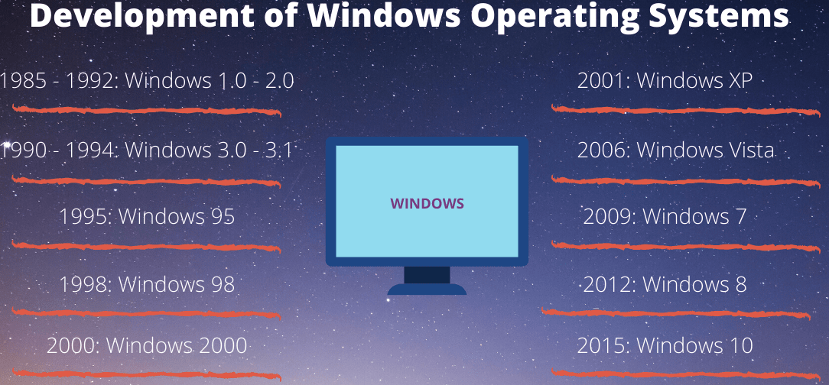
Windows Operating Systems Versions and features
www.lpu.in Lovely Professional University
38

Slide 39
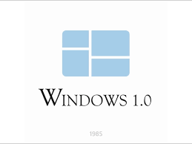
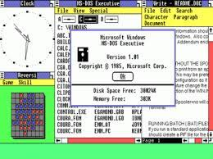
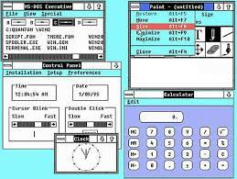
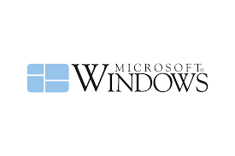
1. Windows 1.0
It was released on November 20, 1985
Pure Operating Environment
Used Graphical User Interface
Simple Graphics
Offered limited multi-tasking was expected to have a better future potential
2. Windows 2.0
It was released on December 9, 1987
16-bit Graphic User Interface (GUI) based operating environment
Introduced Control Panel, and the first version of MS Word and Excel
Unlike Windows 1.0, it had the capacity to allow applications to overlap each other
It was also the last Windows OS which did not require a hard disk
Hardware played an important role
39

Slide 40
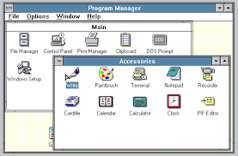
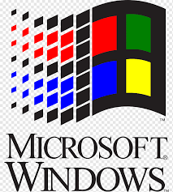
3. Windows 3.0
It was released in 1990
It was better at multitasking
Used 8086 microprocessors
It has both, conventional and extendable memory
First version of Windows to gather critical appreciation
Better memory/ storage
Note* – None of the above mentioned Windows was Operating Systems. They all came under the category of Windows, working based on a graphical operating environment. It was Windows 95, which was the first Operating System released by Microsoft.
www.lpu.in Lovely Professional University
40

Slide 41
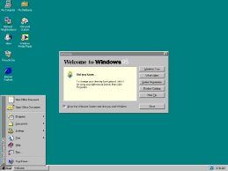
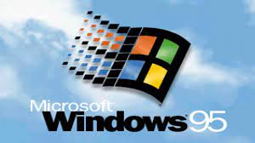
4. Window 95
It was the first complete Operating System
It was released on August 15, 1995
It merged MS-DOS and Windows products
It simplified plug and play features
Taskbar and Start menu was introduced with this Windows OS
Advanced from 16 bit GUI to 32 bit GUI
Long file names could be saved
Initially, computers with Windows 95 did not have Internet Explorer installed but by the release date of Windows 95, the first version of Internet Explorer was installed in the software
On December 31, 2001, Windows declared this version of OS outdated and ended its support for the same
www.lpu.in Lovely Professional University
41

Slide 42
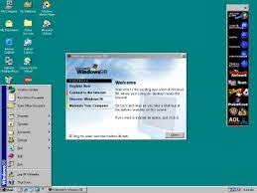
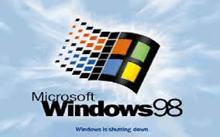
5. Windows 98
It was released to manufacturing on May 15, 1998
It was a 16 bit and 32 bit product based on MS DOS
It was not an entirely new version but just a tuned-up version to Windows 95
Internet Explorer 4.01 was released along with this Windows version
It did not support USB printers or mass storage devices
An update to this version “Windows SE” was released in 1999
www.lpu.in Lovely Professional University
42

Slide 43
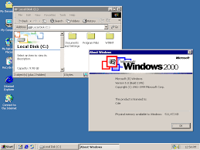
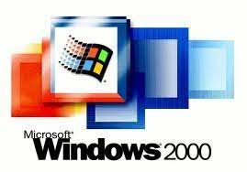
6. Windows 2000
It was officially released on February 17, 2000. However, its manufacturing had begun in late 1999
A core set of features was followed for manufacturing Windows 2000 but 4 different editions, targeting different sectors of the market were released. These included: Server, Professional, Advanced Server and Datacenter Server
It was considered as one of the most secure OS ever
A local disk manager was introduced with these Windows
Multilingual User Interface – it supported many different languages
www.lpu.in Lovely Professional University
43

Slide 44
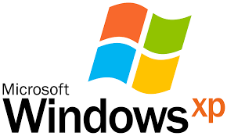
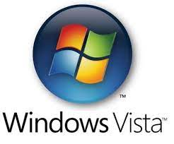
7. Windows XP
While the manufacturing started on August 24, 2001, the official product was released on October 25, 2001
Advanced portable PC support
Automatic wireless connection support
Fast start-up
Better Graphical User Interface (GUI)
Help and support centre
8. Windows Vista
It was released on January 30, 2007
It had an upgraded version of Graphical User Interface
It was the first operating system to use DVD-ROM for installation
www.lpu.in Lovely Professional University
44

Slide 45
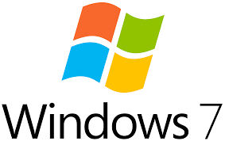
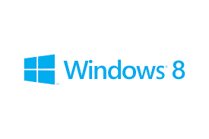
9. Windows 7
It was released on October 22, 2009
A large number of new features were introduced
Redesigned Windows shell with an updated taskbar
Incremental upgrade to the Windows line
Libraries were added in the file management system
A few features from the past Windows were removed
Extended hardware support
10. Windows 8
It was released for retail on October 26, 2012
Optimisations for touch-based. Installed in new devices like Laptops, Mobile phones, tablets, etc.
Increased integration with cloud services. Windows Store service for software distribution. Task manager had been redesigned
New security features were introduced
Online Applications could be directly downloaded
www.lpu.in Lovely Professional University
45

Slide 46
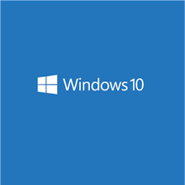
11. Windows 10
It was released on July 29, 2015
Addresses shortcomings in the user interface first introduced with Windows 8
A virtual desktop system
It had the ability to run windows store apps within windows on the desktop rather than in the full-screen mode
Included new icons
To reduce storage shortcomings, Windows 10 automatically compresses the file size
www.lpu.in Lovely Professional University
46

Slide 47
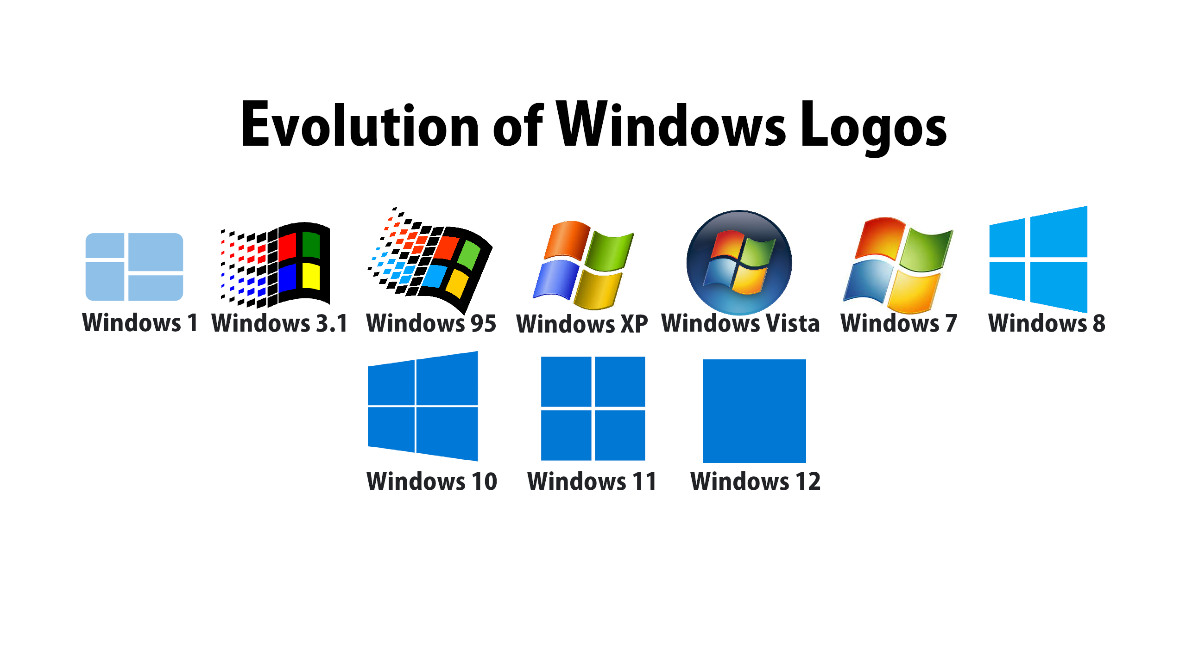

Slide 48
Installation process
Set up the display environment
Erase the primary boot disk
Set up the BIOS
Install the operating system
Install the operating system, update the drivers, and run operating system updates, as necessary.
www.lpu.in Lovely Professional University
48
Notes:
https://www.computerhope.com/issues/ch001838.htm
https://www.wikihow.com/Install-Windows-10
48

Slide 49
Directory Structure
Symbol table of files that stores all related information about a file it holds with its contents
Directory
F 1
F 2
F 3
F 4
Files
F n
Both the directory structure and the files reside on disk
Backups of these two structures are kept on tapes
www.lpu.in Lovely Professional University
Notes:
49

Slide 50
Operations Performed on Directory
Directory: collection of files and folders in hiereachy
A Symbol Table that translates file names into their directory entry.
Operations:
Search for a file
Create a file
Delete a file
List a directory
Rename a file
Traverse the file system : Search all directories/ sub directories and files
www.lpu.in Lovely Professional University
Notes:
50
50

Slide 51
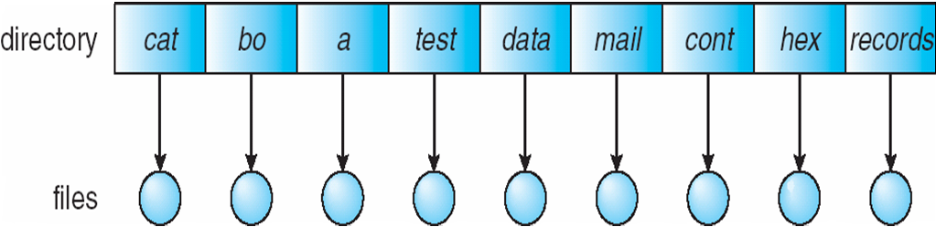
Directory Schemes
Single Level Directory
One directory many files
Single-Level Directory
Easy to support and understand.
Limitation:
When number of files increases or when the system has more than one user, then Naming problem occurs. All files should have unique names.
Disadvantage:
Difficult to remember the name of files when files increases
Single directory for all users
File names created by different users should be different.
www.lpu.in Lovely Professional University
Notes:
51
51

Slide 52
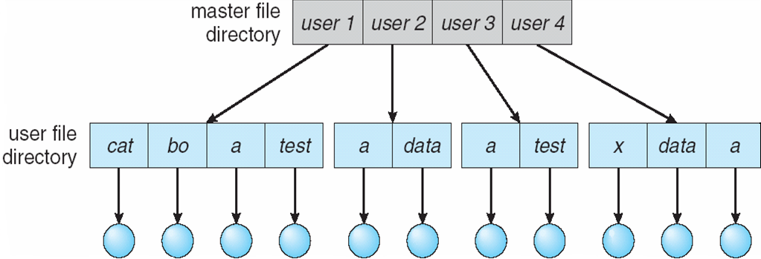
Two Level
2. Two level directory, each user has his own user file directory(UFD).
UFDs have the similar structure, but each lists files of a single user.
www.lpu.in Lovely Professional University
Notes:
52
52

Slide 53
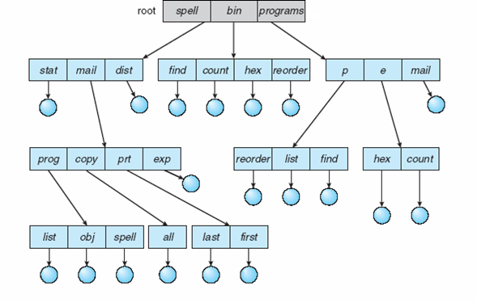
Tree Structure
Users can create their sub directories to manage the files.
Three has Root directory and files have unique file names
www.lpu.in Lovely Professional University
Notes:
53
53

Slide 54
Acyclic-Graph Directories
Multiple users can Have shared subdirectories and files
Users have their own working directory and may have one shared directory
Shared subdirectory created by one user in one directory is automatically visible to all users sharing that directory.
Shared directory or file may exist at multiple places simultaneously
Because of sharing, a file may have multiple absolute paths
So different names can refer to same file
www.lpu.in Lovely Professional University
Notes:
54
54

Slide 55
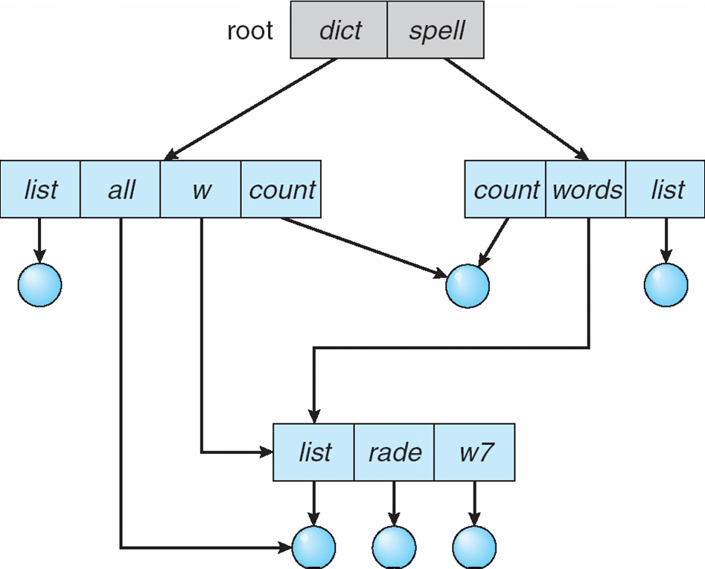
Acyclic-Graph Directories
www.lpu.in Lovely Professional University
Notes:
55
55

Slide 56
General Graph Directories
Created by adding links to the existing directory
Allows cycles in the same directory
As all files are dependent / linked deleting a main file may harm other files
In case of deletion: Garbage Collection is used
In First Pass: Traversing the entire file and marking everything that can be accessed
In Second Pass: Collect everything that is not marked as the free space
www.lpu.in Lovely Professional University
Notes:
56

Slide 57
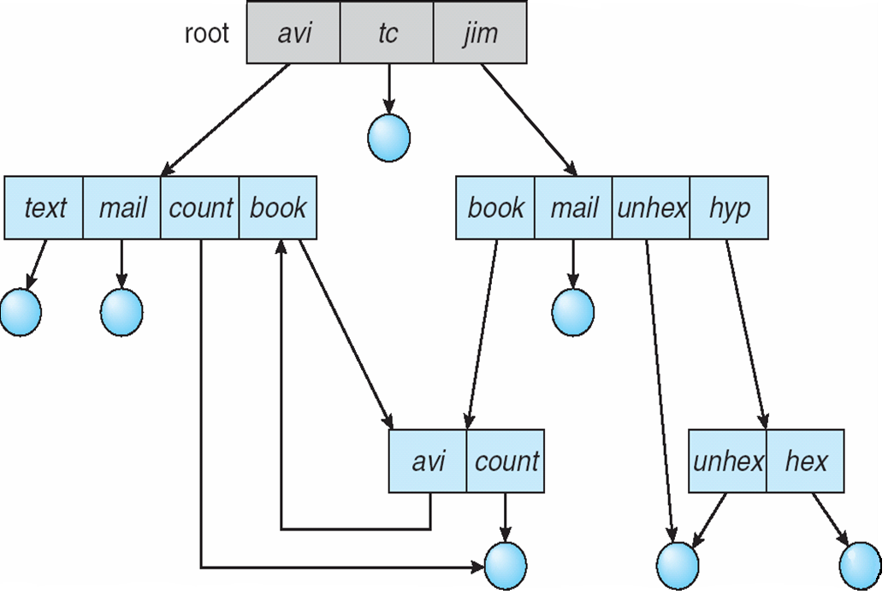
General Graph Directories
There can be cycle in the directory arrangement
General Graph Directory
www.lpu.in Lovely Professional University
Notes:
57
57

Slide 58
Directory Implementation
Directories need to be fast to search, insert, and delete, with a minimum of wasted disk space.
1 Linear List
A linear list is the simplest and easiest directory structure
Finding a file requires a linear search.
Deletions can be done by moving all or one entry to vacant position and deleting the pointer.
2 Hash Table
A hash table can also be used to speed up searches.
Implementation is by using Hash value.
(Division/Variant Method)
www.lpu.in Lovely Professional University
Notes:
58
58

Slide 59
Bootloader
A boot loader, also called a boot manager, is a small program that places the operating system (OS) of a computer into memory.
When a computer is powered-up or restarted, the basic input/output system (BIOS) performs some initial tests, and then transfers control to the Master Boot Record (MBR) where the boot loader resides.
Most new computers are shipped with boot loaders for some version of Microsoft Windows or the Mac OS.
If a computer is to be used with Linux, a special boot loader must be installed.
www.lpu.in Lovely Professional University
59
Notes:
59

Slide 60
Bootloader
The two most common boot loaders are known as:
LILO (LInux LOader) and
LOADLIN (LOAD LINux).
An alternative boot loader, called GRUB (GRand Unified Bootloader), is used with Red Hat Linux.
LILO is the most popular boot loader among computer users that employ Linux as the main, or only, operating system.
www.lpu.in Lovely Professional University
60
Notes:
60

Slide 61
Bootloader
LOADLIN is preferred by some users whose computers have multiple operating systems, and who spend relatively little time in Linux.
LOADLIN is sometimes used as a backup boot loader for Linux in case LILO fails.
GRUB is preferred by many users of Red Hat Linux, because it is the default boot loader for that distribution.
www.lpu.in Lovely Professional University
61
Notes:
61

Slide 62
Linux OS and its features
Linux is one of popular version of UNIX operating System.
It is open source as its source code is freely available.
It is free to use.
Linux was designed considering UNIX compatibility.
Its functionality list is quite similar to that of UNIX.
www.lpu.in Lovely Professional University
62
Notes:
https://www.tutorialspoint.com/operating_system/os_linux.htm
62

Slide 63
Linux OS and its features
Components of Linux System
Linux Operating System has primarily three components
Kernel − Kernel is the core part of Linux. It is responsible for all major activities of this operating system. It consists of various modules and it interacts directly with the underlying hardware. Kernel provides the required abstraction to hide low level hardware details to system or application programs.
System Library − System libraries are special functions or programs using which application programs or system utilities accesses Kernel's features. These libraries implement most of the functionalities of the operating system and do not requires kernel module's code access rights.
System Utility − System Utility programs are responsible to do specialized, individual level tasks.
www.lpu.in Lovely Professional University
63
Notes:
https://www.tutorialspoint.com/operating_system/os_linux.htm
63

Slide 64
Kernel Mode vs User Mode
Kernel component code executes in a special privileged mode called kernel mode with full access to all resources of the computer. This code represents a single process, executes in single address space and do not require any context switch and hence is very efficient and fast. Kernel runs each processes and provides system services to processes, provides protected access to hardware to processes.
Support code which is not required to run in kernel mode is in System Library. User programs and other system programs works in User Mode which has no access to system hardware and kernel code. User programs/ utilities use System libraries to access Kernel functions to get system's low level tasks.
www.lpu.in Lovely Professional University
64

Slide 65
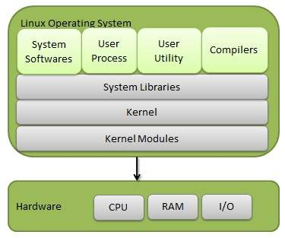
www.lpu.in Lovely Professional University
65

Slide 66
Basic Features
Portable − Portability means software can works on different types of hardware in same way. Linux kernel and application programs supports their installation on any kind of hardware platform.
Open Source − Linux source code is freely available and it is community based development project. Multiple teams work in collaboration to enhance the capability of Linux operating system and it is continuously evolving.
Multi-User − Linux is a multiuser system means multiple users can access system resources like memory/ ram/ application programs at same time.
Multiprogramming − Linux is a multiprogramming system means multiple applications can run at same time.
Hierarchical File System − Linux provides a standard file structure in which system files/ user files are arranged.
Shell − Linux provides a special interpreter program which can be used to execute commands of the operating system. It can be used to do various types of operations, call application programs. etc.
Security − Linux provides user security using authentication features like password protection/ controlled access to specific files/ encryption of data.
66
www.lpu.in Lovely Professional University

Slide 67
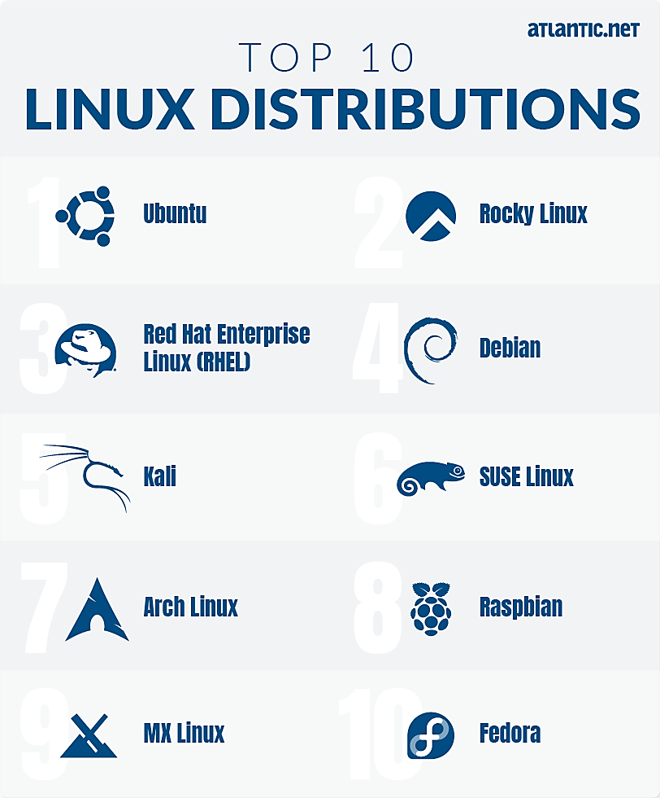
Distribution versions
www.lpu.in Lovely Professional University
67

Slide 68
Installation
Insert a bootable Linux USB drive
Click the start menu
Then hold down the SHIFT key while clicking Restart
Then select Use a Device
Find your device in the list
Your computer will now boot Linux
Select Install Linux
Go through the installation process
www.lpu.in Lovely Professional University
68
Notes:
Reference Links:
Centos:
https://vitux.com/install-centos-with-virtualbox-on-windows/
Ubuntu:
https://www.wikihow.com/Install-Ubuntu-on-VirtualBox
68

Slide 69
Linux Directory Structure and File System Hierarchy
Dir | Description
/ | The directory called "root." It is the starting point for the file system hierarchy. Note that this is not related to the root, or superuser, account.
/bin | Binaries and other executable programs.
/etc | System configuration files.
/home | Home directories.
/opt | Optional or third party software.
/tmp | Temporary space, typically cleared on reboot.
/usr | User related programs.
/var | Variable data, most notably log files.
www.lpu.in Lovely Professional University
69

Slide 70
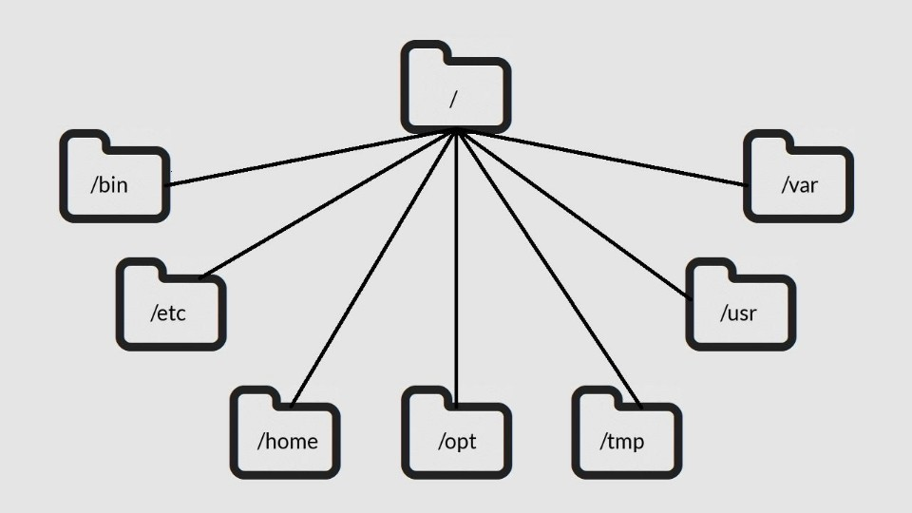
www.lpu.in Lovely Professional University
70
Notes:
https://www.linuxtrainingacademy.com/linux-directory-structure-and-file-system-hierarchy/
70

Slide 71
How to partition a disk in Linux
Creating and deleting partitions in Linux is a regular practice because storage devices (such as hard drives and USB drives) must be structured in some way before they can be used.
In most cases, large storage devices are divided into separate sections called partitions. Partitioning also allows you to divide your hard drive into isolated sections, where each section behaves as its own hard drive.
www.lpu.in Lovely Professional University
71
Notes:
https://opensource.com/article/18/6/how-partition-disk-linux
71

Slide 72
How to partition a disk in Linux
The following explains the process of partitioning a storage device with the parted command.
List the partitions: Use parted -l to identify the storage device you want to partition.
Typically, the first hard disk (/dev/sda or /dev/vda) will contain the operating system, so look for another disk to find the one you want (e.g., /dev/sdb, /dev/sdc, /dev/vdb, /dev/vdc, etc.).
www.lpu.in Lovely Professional University
72
Notes:
https://opensource.com/article/18/6/how-partition-disk-linux
72

Slide 73
2. Open the storage device: Use parted to begin working with the selected storage device. It is important to indicate the specific device you want to use. If you just type parted with no device name, it will randomly select a storage device to modify.
3. Set the partition table: Set the partition table type to GPT, then type "Yes" to accept it. The mklabel and mktable commands are used for the same purpose (making a partition table on a storage device). The supported partition tables are: aix, amiga, bsd, dvh, gpt, mac, ms-dos, pc98, sun, and loop. Remember mklabel will not make a partition, rather it will make a partition table.
www.lpu.in Lovely Professional University
73

Slide 74
4. Review the partition table: Show information about the storage device.
5. Get help: To find out how to make a new partition, type: (parted) help mkpart.
6. Make a partition: To make a new partition (in this example, 1,396MB on partition 0), type the following:
(parted) mkpart primary 0 1396MB
www.lpu.in Lovely Professional University
74

Slide 75
Comparison of Windows and Linux OS
S.NO | Linux | Windows
1. | Linux is a open source operating system. | While windows are the not the open source operating system.
2. | Linux is free of cost. | While it is costly.
3. | It’s file name case-sensitive. | While it’s file name is case-insensitive.
4. | In linux, monolithic kernel is used. | While in this, micro kernel is used.
5. | Linux is more efficient in comparison of windows. | While windows are less efficient.
6. | There is forward slash is used for Separating the directories. | While there is back slash is used for Separating the directories.
7. | Linux provides more security than windows. | While it provides less security than linux.
8. | Linux is widely used in hacking purpose based systems. | While windows does not provide much efficiency in hacking.
9. | There are 3 types of user account – (1) Regular , (2) Root , (3) Service account | There are 4 types of user account – (1) Administrator , (2) Standard , (3) Child , (4) Guest
10. | Root user is the super user and has all administrative privileges. | Administrator user has all administrative privileges of computers.
11. | Linux file naming convention in case sensitive. Thus, sample and SAMPLE are 2 different files in Linux/Unix operating system. | In Windows, you cannot have 2 files with the same name in the same folder.
www.lpu.in Lovely Professional University
75
Notes:
https://www.geeksforgeeks.org/difference-between-linux-and-windows/
75

Slide 76
Virtual Machines
A Virtual Machine (VM) is a compute resource that uses software instead of a physical computer to run programs and deploy apps. One or more virtual “guest” machines run on a physical “host” machine. Each virtual machine runs its own operating system and functions separately from the other VMs, even when they are all running on the same host. This means that, for example, a virtual MacOS virtual machine can run on a physical PC.
Virtual machine technology is used for many use cases across on-premises and cloud environments. More recently, public cloud services are using virtual machines to provide virtual application resources to multiple users at once, for even more cost efficient and flexible compute.
www.lpu.in Lovely Professional University
76
Notes:
https://www.vmware.com/topics/glossary/content/virtual-machine.html#:~:text=A%20Virtual%20Machine%20(VM)%20is,a%20physical%20%E2%80%9Chost%E2%80%9D%20machine.
76

Slide 77
What are virtual machines used for?
Virtual machines (VMs) allow a business to run an operating system that behaves like a completely separate computer in an app window on a desktop.
VMs may be deployed to accommodate different levels of processing power needs, to run software that requires a different operating system, or to test applications in a safe, sandboxed environment.
Virtual machines have historically been used for server virtualization, which enables IT teams to consolidate their computing resources and improve efficiency.
www.lpu.in Lovely Professional University
77

Slide 78
What are virtual machines used for?
Additionally, virtual machines can perform specific tasks considered too risky to carry out in a host environment, such as accessing virus-infected data or testing operating systems. Since the virtual machine is separated from the rest of the system, the software inside the virtual machine cannot tamper with the host computer.
How do virtual machines work?
The virtual machine runs as a process in an application window, similar to any other application, on the operating system of the physical machine. Key files that make up a virtual machine include a log file, NVRAM setting file, virtual disk file and configuration file.
www.lpu.in Lovely Professional University
78

